Slide 1
Becoming a More Engaging Speaker

Slide 2
PRESENTED BY
Chris Griesinger
Director of Implementation & Training
LCS EXPERIENCE
10 years with LCS/Rent Manager
I provide direction to three teams:
Implementation
Training
Documentation

Slide 3
PRESENTED BY
Chris Griesinger
Director of Implementation & Training
SPEAKER EXPERIENCE
Presenter at 9 Rent Manager User Conferences
Teradata SQL Trainer
Standup Comedian (sometimes)
Community & Collegiate Theater
Collegiate Forensicator

Slide 5
Forensics *(Speech & Debate) Experience
Interpretative Events
Public Address
Limited Prep

Slide 6
Forensics *(Speech) Experience
1st Prose
1st Persuasion
1st After Dinner Speaking
2nd Informative
Womp.

Slide 7
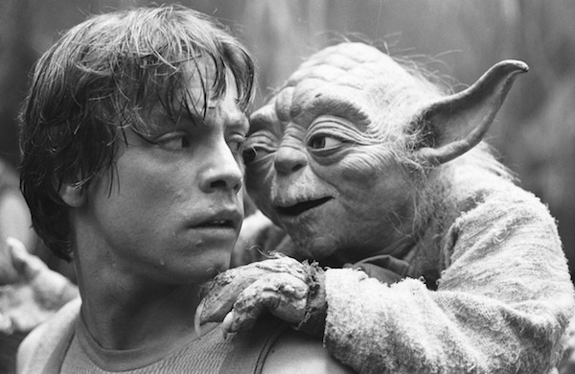
Difficult, it is, to coach speaking skills.

Slide 8
What makes someone a good speaker?

Slide 11
The Medium is the Message
The form of the (communication) medium embeds itself in any message it would transmit or convey, creating a symbiotic relationship by which the medium influences how the message is perceived.
Marshal McLuhan
Communication Scholar

Slide 12
In verbal communication, you are the medium

Slide 13
Medium > Message
100-150
How many words does the average person speak per minute?
400-500
How many words does the average person process per minute?
*** University of Missouri Report

Slide 14
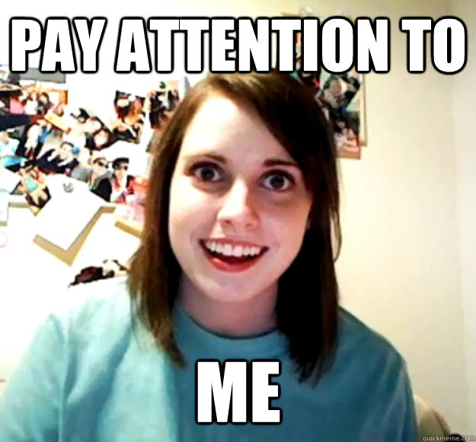
At best…
Your message can only occupy 20-40% of someone’s attention.

Slide 15
Competing For Attention
Something Trump Said
Job
Upcoming
Schedule
Daydreaming
Predictions
Cell Phone

Slide 16
Predictions
Avoid Being Predictable
If your audience can successfully predict what you’re going to say, they’ll lose focus. The human brain is conditioned with a limited attention span, and will only focus on something for as long as it thinks it needs to “get the message.”
We often make this mistake in PowerPoint presentations. We type everything we want to say on the PowerPoint, but we forget the audience can mentally process faster than we can talk, which means they have read everything on the screen before you’ve said it. They no longer feel the need to listen because they already know what you’re going to say… in short, it makes them feel smarter than you which is not good for your credibility.
Sorry it took me so long to get to this last sentence. Maybe I shouldn’t have made it so easy for you to predict me. Let’s try this…

Slide 17
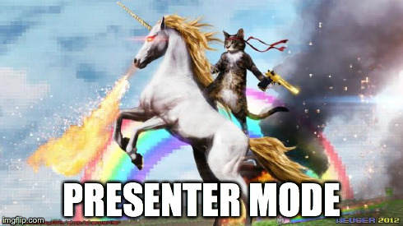
So what do you think I’m going to say on this slide?
Hmmm??
That’s what I thought.

Slide 18
The brain focuses on its greatest need.
The brain is not designed for multi-tasking.
The brain is designed to “cut corners.”

Slide 19
Scrambled Words
Aoccdrnig to rscheearch at Cmabrigde Uinervtisy, it deosn't mttaer in waht oredr the ltteers in a wrod are, the olny iprmoetnt tihng is taht the frist and lsat ltteer be at the rghit pclae.

Slide 20
Communication is a
Biological Draw

Slide 21
Other Biological draws
Light
Controlled Energy

Slide 22
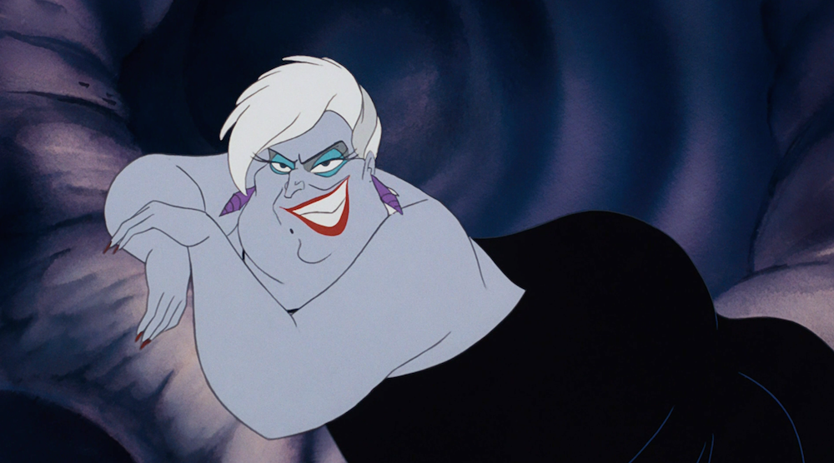
kINESICS
Stance
Gestures

Slide 23
You can sit down

Slide 24
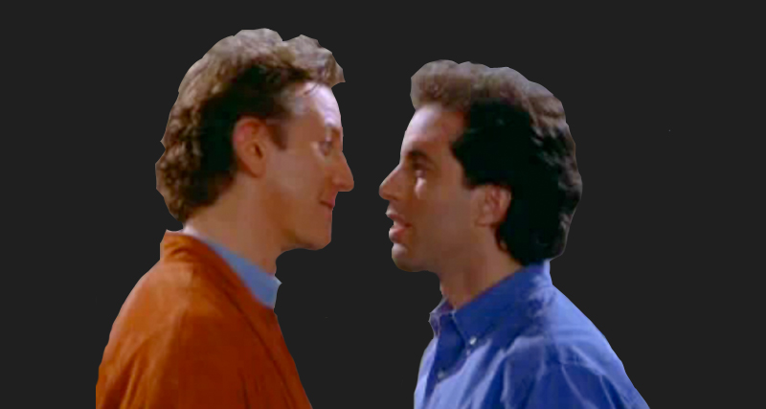
Proxemics
Audience Awareness
Anchors

Slide 25
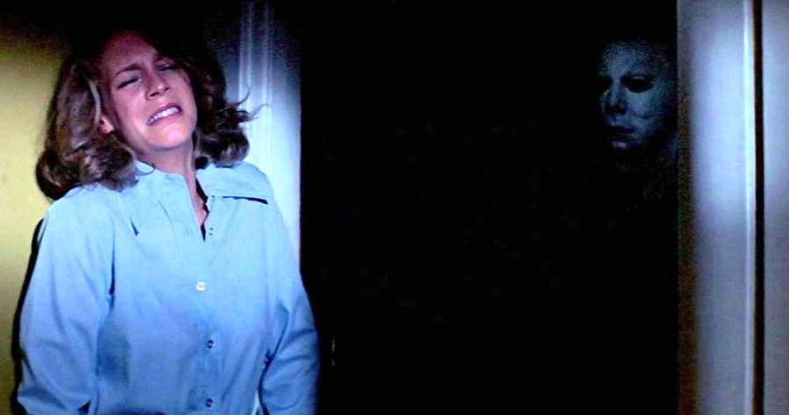
Oculesics
Intimacy
Panning

Slide 26
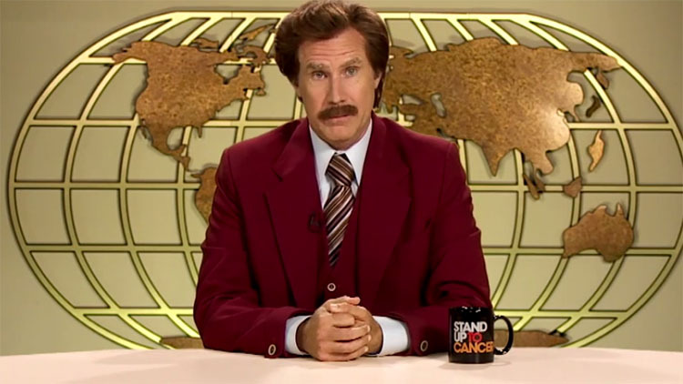
PARALANGUAGE
Inflection
Speed
Cadence
Silence

Slide 27
Effective
communication is transactional.

Slide 28
Verbal Signs of Active Listening
Remembering
Questioning
Reflection
Summarization

Slide 29
Non-Verbal Signs of Active Listening
Smiling
Eye Contact
Forward Posture
Mirroring
No Distractions

Slide 30
Brain Facts
The brain’s memory capacity is a quadrillion bytes.
The brain is capable of 1016 processes per second. 30x faster than the fastest supercomputer.
70% of your thoughts per day are negative, self-critical, pessimistic, and fearful
*** From the Article “72 Amazing Human Brain Facts” on BeBrainFit.com

Slide 31
Tapping Into Your Potential
Believe in yourself
Eliminate distractions
Focus on what’s important

Slide 32
How many students (blue people) were in the last picture?

Slide 33
1
2
3
4
6
5

Slide 34
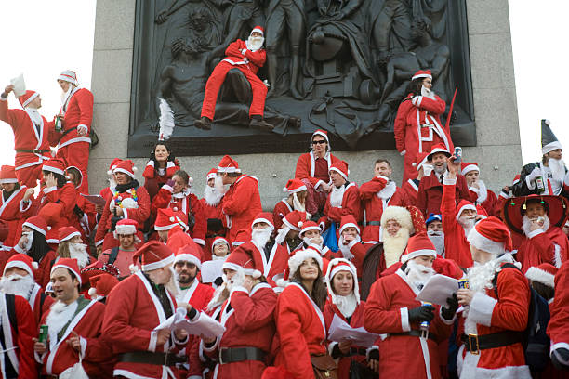
Pay Attention!
Stop counting the Santas!
Tell your brain that HOW you communicate is as important as WHAT you communicate.
The Medium is the Message

Slide 36
Your Voice Matters

Slide 38
Online survey
Open the RMUC18 Mobile App, or visit conference.rentmanager.com/app
Go to Menu and select Schedule
Select Tuesday and Becoming a More Engaging Speaker
Click the Description, then the Online Survey link
Fill out and submit the survey

Slide 39
Presentation Tips
1
Stop living in the past and future.
Start focusing exclusively on your immediate surroundings.
2
Stop focusing exclusively on your message.
Start focusing on the medium – how you’ll deliver your message.
3
Stop focusing on talking.
Start focusing on responding.
4
Stop letting your mind wander.
Start setting communication goals to focus your brain.

Slide 40
Strong communicators take advantage of
Biological
Focus

